Slide 1
JAVA MVC
改编自Daniel Liang: Introduction to programming JAVA课件

Slide 2
JavaBeans和bean事件
类：
数据成员
方法
构造方法
JavaBeans组件
公共类
公共无参构造方法
可序列化
可能有访问器/修改器方法
可能有注册/注销方法

Slide 3
如何理解JavaBeans
组件
可重用，满足一定规范
接口
例子：GUI 界面类，如Jbutton等
类，对象

Slide 4
JAVA事件模型
一个bean可以和其他bean相互通信。
Java事件模型
事件对象 （EventObject）
源对象 （如JButton）
事件监听器对象 (如实现了ActionListener的类的一个对象)

Slide 5
事件处理过程

Slide 6
创建自定义源组件
源组件
注册与注销方法 （注册监听器对象）
包含特定代码，可以创建事件对象，以及通过传递这个事件对象去调用监听器的处理器
负责注册监听器、创建事件、调用在监听器接口中定义的方法通知监听器

Slide 7
例子
招生如果超出限额时，进行处理
代码：CourseWithActionEvent
利用已有的事件组（ActionEvent+ActionListener）
比较其他实现方法

Slide 8
利用已有事件组
java.awt.event.ActionEvent extends java.util.EventObject
Methods：ActionEvent(source:Object, id:int,Command:String)
getActionCommand ():String
getModifier():int
getWhen():long
interface ActionListener implements java.util.EventListener
actionPerformed(e: ActionEvent):void

Slide 10
自定义事件组
可以增加些自定义的属性
事件组：事件+监听器
继承 java.util.EventObject和java.util.EventListener
注意：创建一个事件时必须指定其源对象，所以事件类没有无参构造方法

Slide 11
自定义事件组
EnrollmentEvent extends java.util.EventObject
Attributes：StudentToEnroll:String
enrollmentCap:int
Methods：EnrollmentEvent(source:Object,students:int,enrollmentCap:int)
getEnrollmentCap():int
getStudentToEnroll():String
Interface EnrollmentListener implements java.util.EventListener
enrollmentExceeded(e: ErollmentEvent):void

Slide 12
例子：

Slide 13
MVC：框架模式
框架模式
用来对软件设计进行分工 （大智慧）
设计模式
对具体问题提出解决方案以提高代码复用率，降低耦合度 （小技巧）

Slide 14
JAVA事件委托模型
提供一种很好的架构支持MVC组件模型开发
模型可以实现为一个带着事件和事件监听器注册方法的源，视图可以实现为监听器，构建模型与视图之间的关系
控制器获取数据传给MVC

Slide 15
Model-View-Controller (MVC)
Separating data storage and handling from the visual representation of the data 将数据存储和处理从数据的可视化表示中分离出来
The component for storing and handling data, known as a model, contains the actual contents of the component. 存储和处理数据
The component for presenting the data, known as a view, handles all essential component behaviors. 显示数据
The controller is a component that is usually responsible for obtaining data. 一般用来获取数据

Slide 16
Benefits of MVC
It makes multiple views possible so that data can be shared through the same model. For example, a model storing student names can simultaneously be displayed in a combo box or in a list box
It simplifies the task of writing complex applications and makes the components scalable and easy to maintain. Changes can be made to the view without affecting the model, and vice versa

Slide 17
Synchronization between Model and View
A model contains data, whereas a view makes the data visible. Once a view is associated with a model, it immediately displays updates to the model.
To achieve consistency and synchronize the model with its dependent views, the model should notify the views when there is a change in a property in the model that is used in the view.
In response to a change notification, the view is responsible for redisplaying the viewing area affected by the property change.
The JDK event delegation model provides a superior architecture for supporting MVC component development.

Slide 18



Example: Developing Model-View-Controller Components
Problem: The example creates a model named CircleModel, a view named CircleView and a controller named CircleControl. CircleModel stores the properties (radius, filled, and color) that describe a circle. filled is a boolean value that indicates whether a circle is filled. CircleView draws a circle according to the properties of the circle. CircleControl enables the user to enter circle properties from a graphical user interface. Create an applet with two buttons named Show Controller and Show View. When click the Show Controller button, the controller is displayed in a frame. When click the Show View button, the view is displayed in a separate frame.
controller
view

Slide 19
CircleModel
The circle model stores the data and notifies any change of data to the listeners. The circle model contains properties radius, filled, and color, as well as the registration/deregistration methods for action event.
CircleModel

Slide 20
CircleView
The view implements ActionListener to listen for notifications from the model. It contains the model as its property. When a model is set in the view, the view is registered with the model. The view extends JPanel to override the paintComponent method to draw the circle according to the properties values specified in the model.
CircleView

Slide 21
CircleController
The controller presents a GUI interface that enables the user to enter circle properties radius, filled, and color. It contains the model as its property. You can use the setModel method to associate a circle model with the controller. It uses a text field to obtain a new radius and a combo box to obtain a boolean value to specify whether the circle is filled.
CircleController

Slide 22
Putting Things Together
Finally, let us create an applet named MVCDemo with two buttons Show Controller and Show View. The Show Controller button displays a controller in a frame and the Show View button displays a view in a separate frame.
MVCDemo

Slide 23
MVC Variations
One variation of the model-view-controller architecture is to combine the controller with the view. In this case, a view not only presents the data, but is also used as an interface to interact with the user and accept user input.
Another variation of the model-view-controller architecture is to add part of the data from the model to the view so that the frequently used data can be accessed directly from the view.

Slide 24
Swing MVC
NOTE: Swing components are designed using the MVC architecture. Each Swing GUI component is a view that uses a model to store data. Many components contain part of the data in the model so that they can be accessed directly from the component.

Slide 25
Swing Model-View-Controller Architecture
Each Swing user interface component (except some containers and dialog boxes such as JPanel, JSplitPane, JFileChooser, and JColorChooser) has a property named model that refers to its data model.
The data model is defined in an interface whose name ends with Model. For example, the model for button component is ButtonModel.
Most model interfaces have a default implementation class that is commonly named DefaultX, where X is its model interface name. For example, the default implementation class for ButtonModel is DefaultButtonModel.

Slide 26
Swing Components and Their Models
For convenience, most Swing components contain some properties of their models, and these properties can be accessed and modified directly from the component without knowing the existence of the model..
For advanced components such as JSpinner, JList, JComboBox, JTable, and JTree, you have to work with their models to store, access and modify data.

Slide 27
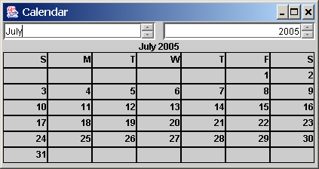
JSpinner
A spinner is a text field with a pair of tiny arrow buttons on its right side that enable the user to select numbers, dates, or values from an ordered sequence. The keyboard up/down arrow keys also cycle through the elements. The user may also be allowed to type a (legal) value directly into the spinner.

Slide 28
The JSpinner Class
A JSpinner's sequence value is defined by the SpinnerModel interface, which manages a potentially unbounded sequence of elements. The model doesn't support indexed random access to sequence elements. Only three sequence elements are accessible at a time: current, next and previous using the methods getValue(), getNextValue(), and getPreviousValue(), respectively.

Slide 29

Example: A Simple JSpinner Demo
Problem: This example creates a JSpinner object for a sequence of numbers and displays the previous, current, and next number from the spinner on a label.
NOTE: If you create a JSpinner object without specifying a model, the spinner displays a sequence of integers.
SimpleSpinner

Slide 30
Spinner Models
SpinnerModel is an interface for all spinner models. AbstractSpinnerModel is a convenience abstract class that implements SpinnerModel and provides the implementation for the registration/deregistration methods. SpinnerListModel, SpinnerNumberModel, and SpinnerDateModel are concrete implementations of SpinnerModel.

Slide 31
SpinnerListModel
SpinnerListModel is a simple implementation of SpinnerModel whose values are stored in a java.util.List.

Slide 32
SpinnerNumberModel
SpinnerNumberModel is a concrete implementation of SpinnerModel that represents a sequence of numbers. It contains the properties maximum, minimum, and stepSize.

Slide 33
SpinnerDateModel
SpinnerDateModel is a concrete implementation of SpinnerModel that represents a sequence of dates. The upper and lower bounds of the sequence are defined by properties called start and end and the size of the increase or decrease computed by the nextValue and previousValue methods is defined by a property called calendarField.

Slide 34
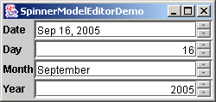
Example: Using Spinner Models and Editors
Problem: This example uses a JSpinner component to display date and three separate JSpinner components to display day in a sequence of numbers, month in a sequence of strings, and year in a sequence of numbers. All these four components are synchronized. For example, if you change year in the spinner for year, the date value in the date spinner is updated accordingly.
SpinnerModelEditorDemo

Slide 35
JList
JList has two supporting models: a list model and a list-selection model. The list model is for storing and processing data. The list-selection model is for selecting items. By default, items are rendered as strings or icons. You can also create a custom renderer implementing the ListCellRenderer interface.

Slide 36
The JList Class

Slide 37
The layoutOrientation property
JList jlst = new JList();
jlst.setLayoutOrientation(int);

Slide 38
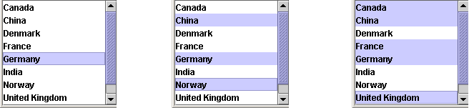
The selectionMode property
JList jlst = new JList();
jlst.setSelectionMode(int);
JList.SINGLE_SELECTION
JList.SINGLE_INTERVAL_SELECTION
JList.MULTIPLE_INTERVAL_SELECTION

Slide 39
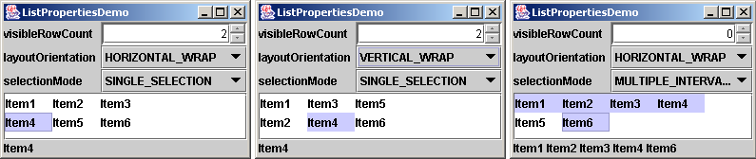
Example: List Properties Demo
Problem: This example creates a list of a fixed number of items displayed as strings. The example enables you to dynamically set visibleRowCount from a spinner, layoutOrientation from a combo box, and selectionMode from a combo box. When you select one or more items, their values are displayed in a status label below the list.
ListPropertiesDemo

Slide 40
List Models
The JList class delegates the responsibilities of storing and maintaining data to its data model. The JList class itself does not have methods for adding or removing items from the list. These methods are supported in ListModel.
AbstractListModel implements the registration methods in the ListModel, but does not implement the getSize and getElementAt methods.
DefaultListModel extends AbstractListModel and implements the two methods getSize and getElementAt, which are not implemented by AbstractListModel.

Slide 41
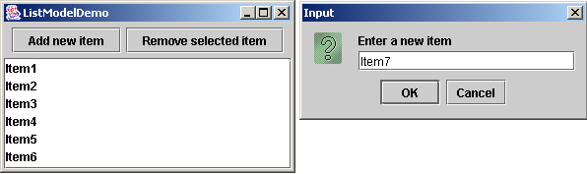
Example: List Model Demo
Problem: This example creates a list using a list model and allows the user to add and delete items in the list. When the user clicks the Add new item button, an input dialog box is displayed to receive a new item.
ListModelDemo

Slide 42
List Cell Renderer
In addition to delegating data storage and processing to list models, JList delegates the rendering of the list cells to list cell renderers.
By default, JList uses DefaultListCellRenderer to render its cells. The DefaultListCellRenderer class implements ListCellRenderer, extends JLabel, and can display either a string or an icon, but not both in the same cell.
All list cell renderers implement the ListCellRenderer interface, which defines a single method, getListCellRendererComponent, as follows
You can create a custom renderer by implementing ListCellRenderer.

Slide 43
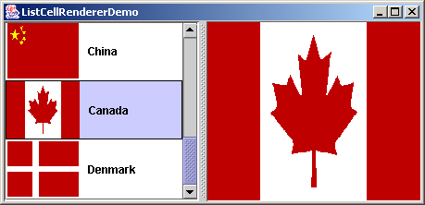
Example: List Cell Renderer Demo
Problem: This example creates a list of countries and displays the country flags and country names in the list. When a country is selected in the list, its flag is displayed in a panel next to the list.
MyListCellRenderer
ListCellRendererDemo

Slide 44
JComboBox

Slide 45
Combo Box Model
JComboBox delegates the responsibilities of storing and maintaining data to its data model. All combo box models implement the ComboBoxModel interface, which extends the ListModel interface and defines the getSelectedItem and setSelectedItem methods for retrieving and setting a selected item.
The methods for adding and removing items are defined in the MutableComboBoxModel interface
DefaultComboBoxModel provides a concrete implementation for ComboModel.

Slide 46
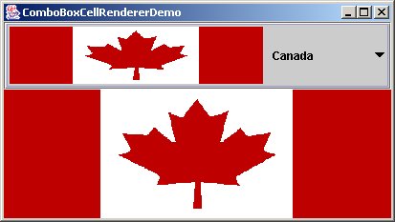
Example: Combo Box Cell Renderer Demo
Problem: This example creates a combo box that contains a list of countries and displays the country flags and country names in the list cell. When a country is selected in the list, its flag is displayed in a panel below the combo box.
ComboBoxCellRenderer

